Slide 1
SGS Information Session - SSHRC Doctoral Awards for students
Fong di caterina
Fall 2023
Important Disclaimer! What is said (or not said) at this info session does not supersede the material contained in the agencies’ guidelines or application packages.
Notes:
Good afternoon, everyone! And, welcome to the SGS Information Sessions for SSHRC Doctoral Awards for students.
My name is Carla Serpe and I am an Acting Graduate Awards Officer here in the Graduate Awards Office at SGS. Joining us is Fong Di Caterina, Manager of the Graduate Awards Office who will be monitoring the chat during the presentation and will help with answering any questions during the Q&A.
To begin, I'd like to start with the Disclaimer you see on the screen...From time to time, SSHRC may update or make changes to the information regarding the competition, which we aren't necessarily notified about. So information that comes directly from the agency supersedes the information we're presenting to you today.

Slide 2
Statement of Acknowledgement of Traditional Land
We wish to acknowledge this land on which the University of Toronto operates.​
For thousands of years it has been the traditional land of the Huron-Wendat, the Seneca, and the Mississaugas of the Credit River.​
​
Today, this meeting place is still the home to many Indigenous people from across Turtle Island and we are grateful to have the opportunity to work on this land.​
Notes:
Before we move onto the presentation, I'd like to begin with the...

Slide 3
MS TEAMS - Asking questions
We are recording this session to be uploaded to the SGS website.​
Quick clarification questions on a particular slide may be entered in the chat during the presentation.​
​
Please save all other questions to the end of the presentation.​ Please email us separately on questions that are personal to your scenario (specifically for calculating the number of months of eligibility), unless it’s general enough that it’ll apply to other applicants as well.
​
Slides will be available on the SGS website under the specific award page: https://www.sgs.utoronto.ca/awards/canada-graduate-scholarships-doctoral-cgs-d%e2%80%8b-program%e2%80%8b/#section_5

Slide 4
AGENDA
Introduction
The Federal Tri-Councils & Subject Matter Eligibility
SSHRC Competition Overview – CGS D & Fellowship
Value & Tenure
Eligibility
Where & How to Apply
Adjudication
Previous Results
Michael Smith Foreign Study Supplement
Questions

Slide 5
introduction
SSHRC Doctoral awards

Slide 6
Federal tri-councils
The major federal source of funds for research and scholarship in academic institutions
Canadian Institutes of Health Research (CIHR)
Natural Sciences and Engineering Research Council (NSERC)
Social Sciences and Humanities Research Council (SSHRC)
Please Note: You may only have one active application per year at one granting agency (NSERC, CIHR or SSHRC), with the exception of Vanier. Subsequent applications to multiple agencies will be disqualified. If you were deemed unsuccessful at your graduate unit for your doctoral application, and if eligible, you may submit a CGS Master’s application, as your doctoral application is no longer considered active.

Slide 7
Value & tenure
CGS Doctoral
$35,000 a year for 36 months
Can only be held at a recognized Canadian university
http://www.nserc-crsng.gc.ca/Students-Etudiants/PG-CS/CGSD-BESCD_eng.asp
SSHRC Doctoral Fellowships
$20,000 a year for up to 48 months
Can be held at a recognized university in Canada or abroad
http://www.sshrc-crsh.gc.ca/funding-financement/programs-programmes/fellowships/doctoral-doctorat-eng.aspx
SSHRC determines the value and duration of an award based on the number of months of full-time doctoral studies that have been completed by December 31 of the year of application. (Not the proposed start date of the award)
Notes:
CGS Doctoral
...we've inlcuded a link to the CGS Doctoral webpage where you can find full details on the scholarship
SSHRC Doctoral Fellowships
… we've also included a link to the SSHRC Doctoral Fellowship webpage where you can find full details on this scholarship

Slide 8
Sshrc basic criteria
Applications to SSHRC must meet the following two criteria:
The proposed research or related activities must be primarily in the social sciences and humanities (i.e., aligned with SSHRC’s legislated mandate).
The intended outcome of research must primarily be to add to our understanding and knowledge of individuals, groups, and societies – what we think, how we live, and how we interact with each other and the world around us
Selecting the Appropriate Federal granting agency: http://www.science.gc.ca/eic/site/063.nsf/eng/h_FEE7261A.html?OpenDocument#SSHRC1
SSHRC Guidelines for Eligibility of Applications Related to Heath: http://www.science.gc.ca/eic/site/063.nsf/eng/h_FEE7261A.html?OpenDocument#SSHRC2
Notes:
If you're not sure whether your research falls under SSHRC or one of the other agencies, please go to the links provided to review the inforamtion. We recommend that applicants review these sites before they decide which agency to apply to.

Slide 9
Subject Matter Eligibility – interdisciplinary/health related research
Applicants with questions or whose subject matter has significant overlap, or future application to health (in particular studying a disease population, therapy or health systems), should email fellowships@sshrc-crsh.gc.ca with a one-page summary of their research proposal in advance of submitting an application to seek clarification or a ruling.
Include a copy of the ruling/email confirmation from SSHRC with your application.
Complete guidelines on selecting the appropriate federal granting agency are available at www.science.gc.ca
Notes:
SSHRC will give advice on where they think the research falls based on a one-page summary that an applicant submits, but their ruling is not set in stone. As the application itself asks for a two-page research proposal and the ruling SSHRC may give is based on a one-page summary, SSHRC may later determine that the research doesn’t fall under SSHRC, so it is important that if you receive a ruling/email confirmation from SSHRC, you include it with your application submission.

Slide 10
Subject Matter Eligibility – interdisciplinary/health related research
Applicants whose proposed research is health-related should consult CIHR’s mandate first to explore eligibility. CIHR has policies and procedures in place to adjudicate the full range of social sciences and humanities research proposals related to health research.
The use of social sciences or humanities theories, methodologies and hypotheses is, in and of itself, not sufficient to make a proposal eligible for SSHRC funding.
Research that is primarily intended to improve health, produce more effective health services and products and/or strengthen the health care system in Canada or internationally (e.g., research concerning the treatment, prevention or diagnosis of a condition, the evaluation of the effectiveness of health programs, the development of health management systems, etc.) is not eligible for consideration at SSHRC.
Applicants must provide a compelling justification for why research falls under SSHRC if the proposal is interdisciplinary or crosses over with health.

Slide 11
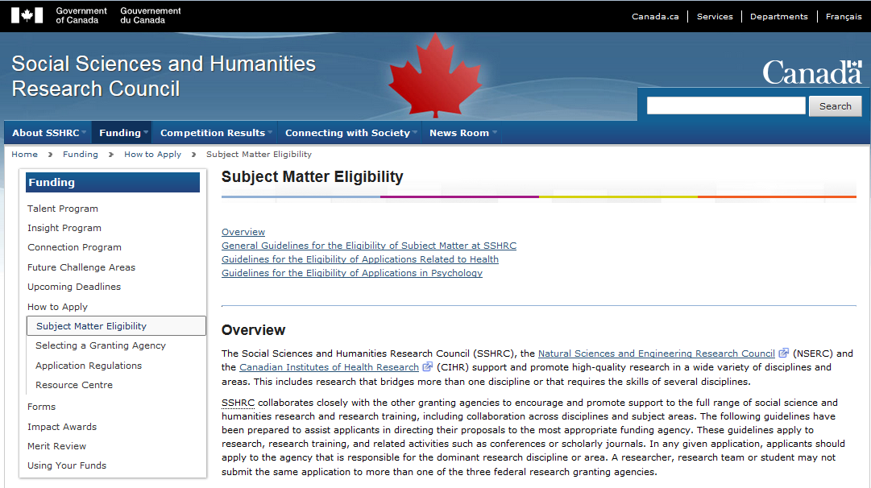
Notes:
Here is a screenshot of what you will see on the SSHRC website under Subject Matter Eligibility.

Slide 12
2024-2025
SSHRC Competition overview

Slide 13
Competition overview
Types of Awards: Through its Doctoral Awards funding opportunity, SSHRC offers two types of funding for doctoral students:
SSHRC Doctoral Fellowships;
Canada Graduate Scholarships (CGS): Doctoral
Applicants apply for both awards by completing one application form. If you are eligible for both awards, SSHRC will automatically consider you for both.
Highest-ranked eligible applicants will be offered a CGS D, next highest ranked applicants will be offered a SSHRC Doctoral Fellowship
Most Canadian universities receive a quota indicating the number of students they can nominate for the national competition.
Deadline to apply is set by each individual graduate unit (department)

Slide 14
Competition overview
U of T Quota: 250
Consult your graduate unit regarding their internal application deadline – this is not the same as the University or SSHRC deadline
Notes:
We have a quota of 259 applications that we can submit to SSHRC this year.
You'll want to consult your graduate unit...

Slide 15
ELIGIBILITY of DEGREE PROGRAM
SSHRC Doctoral Awards are tenable only in degree programs that include significant original, autonomous research that leads to the completion of a:
Dissertation; or
Major scholarly publication; or
Performance/recital; or
Exhibit
which is a requirement for the completion of the program and is merit reviewed at the institutional level.

Slide 16
ELIGIBILITY TO APPLY
Be a citizen, permanent resident, or protected person of Canada at the time of application
Be applying for support to pursue doctoral studies in the social sciences or humanities;
Not have already received a doctoral level award from SSHRC, NSERC or CIHR;
Not have exceeded the allowable number of months already spent in doctoral study;
Submit a maximum of one scholarship (master’s or doctoral) or fellowship application per academic year to either CIHR, NSERC or SSHRC. Should more than one application be submitted, the eligible application submitted first chronologically will be retained. Nominations to the Vanier CGS program and applications to the Banting Postdoctoral Fellowships program do not count toward this limit (other exceptions may apply to CIHR internships);
Not hold a tenure or tenure-track (faculty) appointment concurrently with a CGS D award.
At the time of application, need not be assured of admission to a degree program.
Please Note: Students may only have one active application per year at one granting agency (NSERC, CIHR or SSHRC), with the exception of Vanier. Subsequent applications to multiple agencies will be disqualified. However, if applicants were deemed unsuccessful at the graduate unit level review for their doctoral applications, and if eligible, they may submit a CGS Master’s application, as the doctoral application is no longer considered active for the competition year.
Notes:
Except Vanier – Because Vanier is a separate competition or award program, students can apply to both.
Can be an incoming student.

Slide 17
MONTHS OF STUDY
CGS Doctoral
Applicants must:
have completed no more than:
24 months of full-time study in their doctoral program OR (revised) the PhD portion of their joint professional undergraduate/PhD program (such as MD/PhD, JD/PhD, DVM/PhD) by December 31 of the calendar year of application if previously enrolled in a graduate program;
36 months of full-time study in their doctoral program by December 31 of the calendar year of application if enrolled directly from a bachelor’s to a PhD program (with no time spent in a graduate program)
direct-entry applicants must be enrolled in their doctoral program at the time of application
students registered in a “Direct Entry PhD” program at U of T who previously completed or were enrolled in any graduate degree program belong in the 24-month category
REVISED have completed no more than 36 months of full-time study in the PhD portion of their joint professional undergraduate/PhD program (such as MD/PhD, JD/Phd, DVM/PhD) by December 31 of the calendar year of application if they have not previously enrolled in another graduate program;
REVISED have completed no more than 36 months of full-time study in their joint program by December 31 of the calendar year of application if enrolled in a joint graduate program (such as, MA/PhD, MSc/PhD, MBA/PhD)
applicants who fall into this category have access to the 36-month window whether or not they were previously enrolled in a master’s program.
Notes:
Joint program or a fast-track program, which is a master’s to PhD transfer,

Slide 18
MONTHS OF STUDY
SSHRC Doctoral Fellowships
Applicants must:
have completed no more than 48 months of full-time study in their doctoral program by December 31 of the year of application
Fast-Track: Applicants registered in a master’s program and then transferred to a doctoral program (fast-track), the months of study completed are calculated starting from the date on which the applicant transfers into the doctoral program.
Joint Programs: Applicants registered in a doctoral program in which they obtain a master’s degree (e.g., MA/PhD), the months of study are calculated starting from the date on which an applicant is officially registered in the joint program (including the master’s portion of the program).
Direct Entry: For applicants registered in a doctoral program directly from an undergraduate program (i.e., never enrolled in a master’s program), the months of study completed are calculated starting from the date on which an applicant begins the doctoral program.
Notes:
Regardless of the type of program they’re in, all students have 48 months. Some applicants may not be eligible for CGS-D but they would still be eligible for SSHRC doctoral fellowships. They can still apply, and if offered an award, it would be a SSHRC doctoral fellowship and not a CGSD.

Slide 19
MONTHS OF STUDY determines award length for sshrc doctoral fellowships
SSHRC applicants who are beyond the eligible months of study for the CGS D, may continue to apply up until their 48th month of study (as of December 31st) and will be considered for a SSHRC Doctoral Fellowship.
Notes:
This chart is from the SSHRC website and shows how many months of the scholarship recipients could be awarded based on how many months of study they’ve completed by December 31 of the year of application, 2023 for this year.
If you've completed between 0 and 12 months, you'll receive 48 months of the scholarship. Also, on the other end, for example, doctoral students who started their degree in September with no leaves of absences can apply as late as the fall session of their 4th year to take up their award for one year starting their fifth year.

Slide 20
Joint (MA/PhD) & Direct-Entry PhD Programs
Joint (MA/PhD) and direct-entry PhD students:
Are eligible to apply for either a CGS Master's award or a Doctoral award if they have completed between zero and 12 months of graduate-level study by December 31, 2023. (Cannot apply to both at the same time).
Students who have completed more than 12 months of graduate-level study by December 31, 2023, can only apply for a Doctoral Award.
Months of Study as of Dec 31 | CGS M | CGS D | SSHRC F’ship
Incoming from Undergrad | Eligible | Ineligible | Eligible
4-12 Months | Eligible | Eligible | Eligible
13-24 Months | Ineligible | Eligible | Eligible
25-36 Months | Ineligible | Eligible | Eligible
37-48 Months | Ineligible | Ineligible | Eligible
Notes:
This is a chart we’ve created to show how this works for students in joint and direct-entry PhD programs.

Slide 21
Current undergraduates
Undergraduate students applying to a direct-entry doctoral program (i.e., never enrolled in a master’s program) should apply for a CGS M to hold in their first year as they are ineligible to apply for a CGS D until they are registered in the doctoral program. In other words, students in a direct-entry doctoral program must wait until they are registered in their first year of their doctoral studies in order to apply for a CGS D.
Although eligible for the SSHRC Doctoral Fellowship, undergraduate students are still encouraged to apply for a CGS M first (success rate for CGS M is much higher at U of T).

Slide 22
Where to apply
If currently registered at or on an approved leave of absence from the University of Toronto for Fall 2023 session in any degree program (including those at master’s or undergraduate level), complete the SSHRC online application form by the current or proposed U of T graduate unit’s deadline
If currently registered at another university for the Fall 2023 session with a SSHRC doctoral quota, the applicant must apply through the other institution, even if they are applying for admission to a doctoral program at the University of Toronto
If not currently registered at a university but was registered at any time in the calendar year of 2023 at an institution with a SSHRC doctoral quota, the applicant must apply through the institution they were most recently registered at during the calendar year and follow that institution’s application process
If the applicant has not been registered in a degree program at any institution with a SSHRC quota during the calendar year of 2023, they must apply directly to SSHRC
Applications submitted directly to SSHRC from eligible U of T applicants will be rendered ineligible.
Notes:
Graduate students, including master’s students, should apply through their current graduate unit.

Slide 23
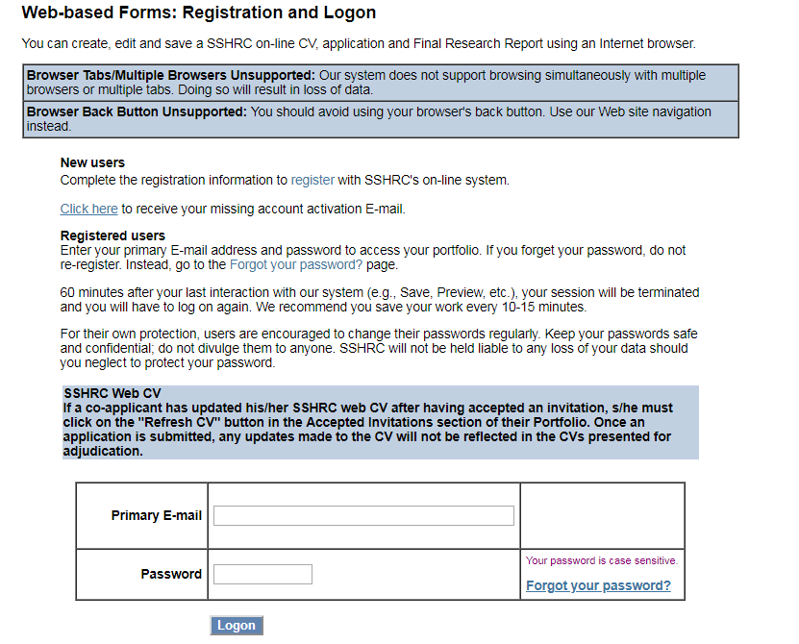
How to apply
Website: https://webapps.nserc.ca/SSHRC/faces/logon.jsp?lang=en_CA
The SSHRC application is completely done online.
Follow your graduate unit’s instructions on whether a paper submission or email notification of submission is required.
Step 1. Register for an account
Step 2. Log in
Step 1.
Step 2.
Notes:
This is the SSHRC On-line system – the link to the site is on the right-hand side. If you’ve never used the system before, start by registering with the system as in Step 1 and go through the activation process.
Once the activation process is done, or if you have used the system before, then you login with your email address and password as in Step 2.

Slide 24
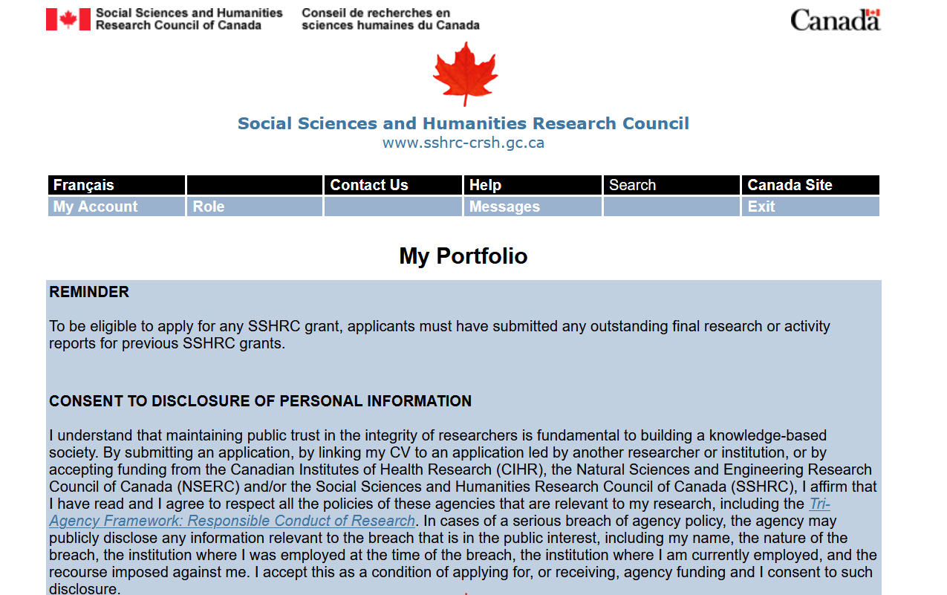
landing page: My Portfolio
Notes:
Once you've logged in, you’ll be taken to the landing page that looks like this. You'll see My Portfolio, and two menu bars across the top.

Slide 25
SELF-IDENTIFICATION DATA
SSHRC (in coordination with NSERC and CIHR) requires all applicants to self-identify with information on age, gender, orientation, Indigenous identity, visible minority status, population group, disabilities, and languages
A harmonized self-identification data collection process allows the granting agencies to monitor the equity performance of its programs and design new measures that achieve greater equity, diversity and inclusion in the research enterprise.
Completing the self-identification form is mandatory for applicants and co-applicants but for each category there is an option of “I prefer not to answer.”
This information is not shared with universities.
To enter your self-identification information, after logging in, select “My Account” from the menu

Slide 26
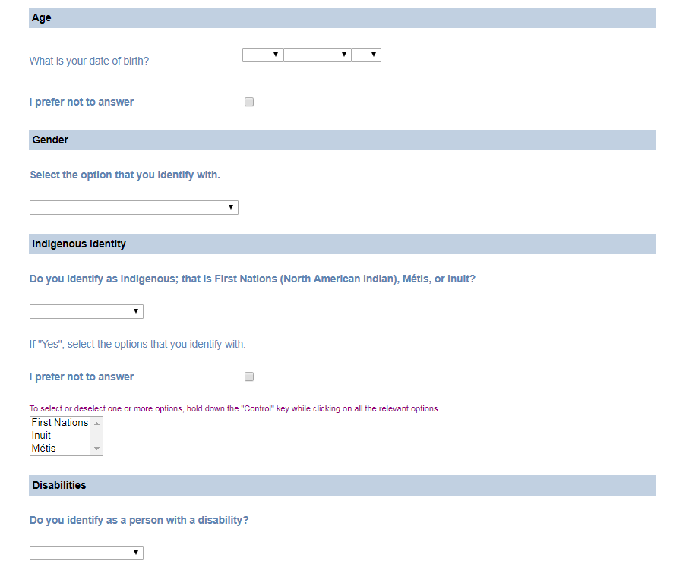
Notes:
This is a screenshot of what that section looks like and where you can self-identify by a number of categories. You can also select 'I prefer not to answer' for any or all of the categories.

Slide 27
Information for black applicants
The Government of Canada has deployed additional funds to increase direct support for Black scholars . CGS D applicants who self-identify as Black and provide consent in their application to be considered for funds designated to specific groups may be able to receive this funding through a doctoral scholarship as part of this initiative. SSHRC has 10 additional CGS D awards reserved for this initiative.
Accordingly, Black applicants are encouraged to self-identify within their respective award applications (in the EDI survey form) in order to be considered for these additional funding opportunities from SSHRC.
At this time, self-identification data is not shared with institutions. Black applicants may use the allowable inclusion section to explain any special circumstances that may have delayed their academic career (e.g., cultural or community responsibilities, and/or challenging socio-economic contexts). This information is taken into account by selection committee members.

Slide 28
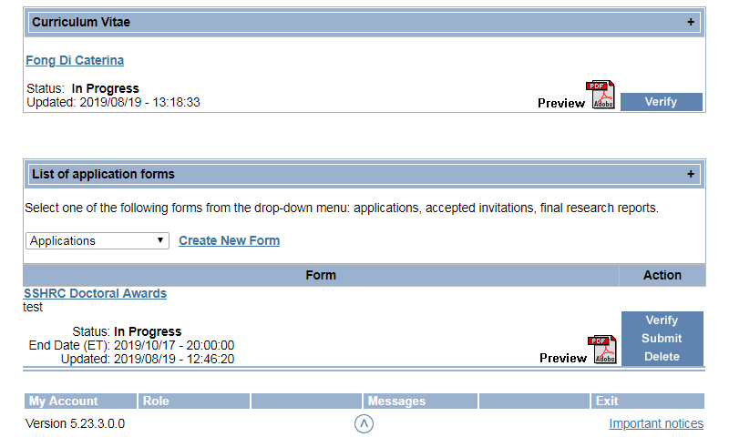
Application components
There are two parts to each application:
Curriculum Vitae
SSHRC Doctoral Awards Form
Both sections must be completed and verified in order to submit the full application.
Notes:
So you'll see on the right in the screenshot that there are two separate sections, one of for the CV and one for the List of application forms, under which your SSHRC Doctoral Award application will appear.

Slide 29
Application components
Curriculum Vitae
Identification
Current Position
Address
Work Experience
Academic Background
Credentials
Research Expertise
Funded Research
SSHRC Online Application Form
Application Profile
Areas of Study
Research Proposal
Bibliography / Citations
Diversity in Research
Transcripts
Allowable Inclusions
Research Contributions
Supplement/Joint or special initiative attachments
Referees
Notes:
The components will appear within the application on the left-hand side of the each section.

Slide 30
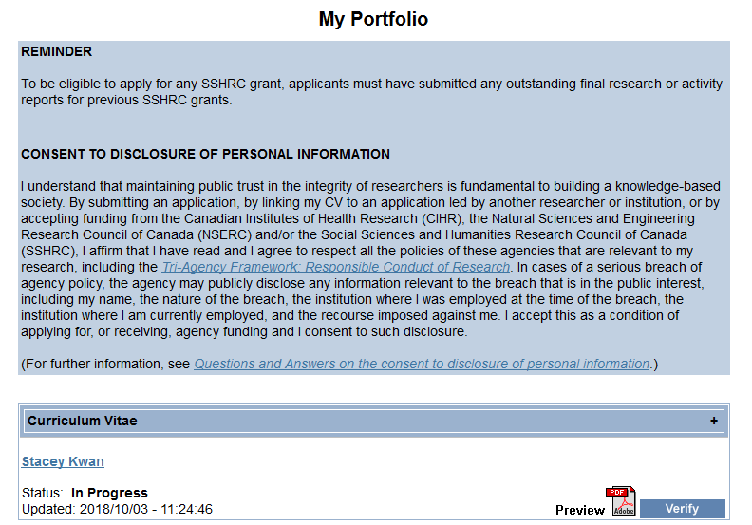
Curriculum Vitae Section
Click anywhere on the blue “Curriculum Vitae” bar for instructions
Notes:
First the CV section.
...

Slide 31
Curriculum Vitae Section
Applicants can edit their CV by clicking their name in the “Curriculum Vitae” section on the “My Portfolio” (landing) page.

Slide 32
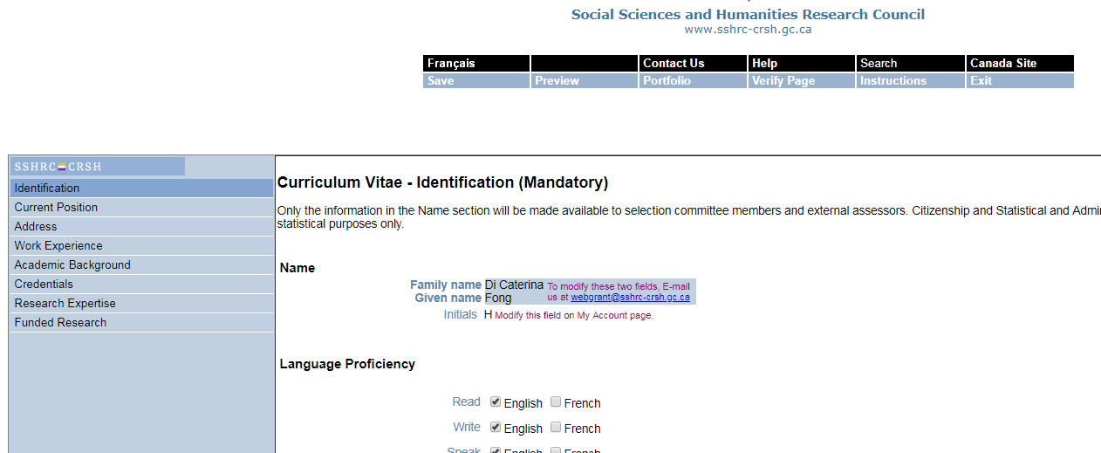
Curriculum Vitae Section
Notes:
And here you'll see all the components of the CV that I listed earlier.
I'd like to draw your attention to the Save and Verify Page menu options at the top of the page. This menu will appear on each page and you can save and verify each page, but you also have the option of verifying the full CV section once you've completed all of the components. Verifying the information will let you know if there are any errors that need to be addressed.

Slide 33
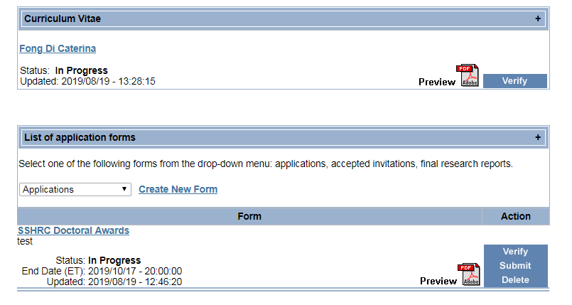
Curriculum Vitae Section
Applicants must “Verify” the CV once they have entered all their CV information.
Notes:
This is where you'll find the 'verify' button for the entire CV section.

Slide 34
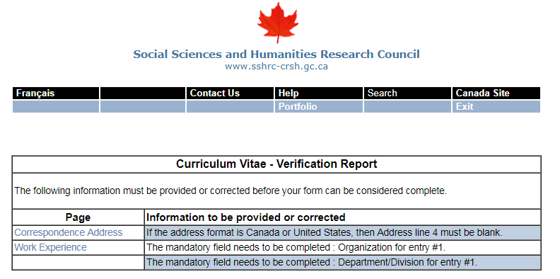
Curriculum Vitae Section
Errors/Corrections
Notes:
Once you verify the CV section, you will receive a verification report if there are any issues. The report will give you the specific component page that the error is in and advise on what needs to be changed.

Slide 35
Verified CV
If you need to make a change to your CV after you’ve verified, you can still edit the CV by clicking your name; however, you will have to verify again.
Strongly recommend that applicants view the CV by clicking the “Preview PDF” option to ensure that the CV is accurate and complete before submitting.
Notes:
Once there are no issues with the CV, you'll see that status updated to 'verified'.

Slide 36
Starting an application
To start a SSHRC Doctoral application, on the “My Portfolio” page look for the section with the header “List of application forms” and select the “Create New Form” link
Notes:
Once the CV is completed, you can create the application form.

Slide 37
Starting an application
In the “Program name” column look for “Doctoral Awards Program” to ensure you are creating the correct application.
In the “Grant type” column, click the “Doctoral Award Programs” link
The icon that looks like paper & question mark, is the link to the application instructions. It is recommended to review the instructions before applying and to bookmark for future reference

Slide 38
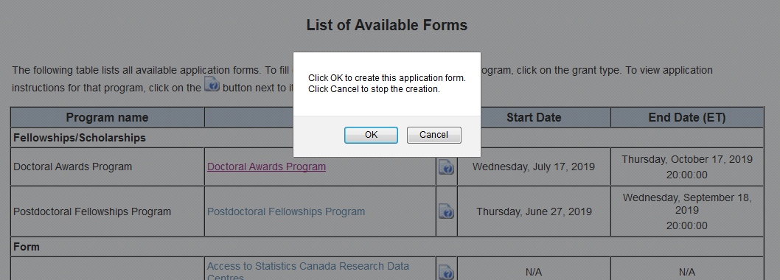
Creating a SSHRC Application form
After selecting “Doctoral Awards Program, a pop-up box will appear, select “OK” to create the application. You will be taken back to the “Portfolio” landing page

Slide 39
Edit application form
To start editing the application, click the “SSHRC Doctoral Awards” link that is now available
Notes:
A new form will appear on the My Portfolio page. You’ll see that there are three options under ‘Action’ on the right, verify, submit, delete. As with the CV, you'll have to verify the application form before you submit.

Slide 40
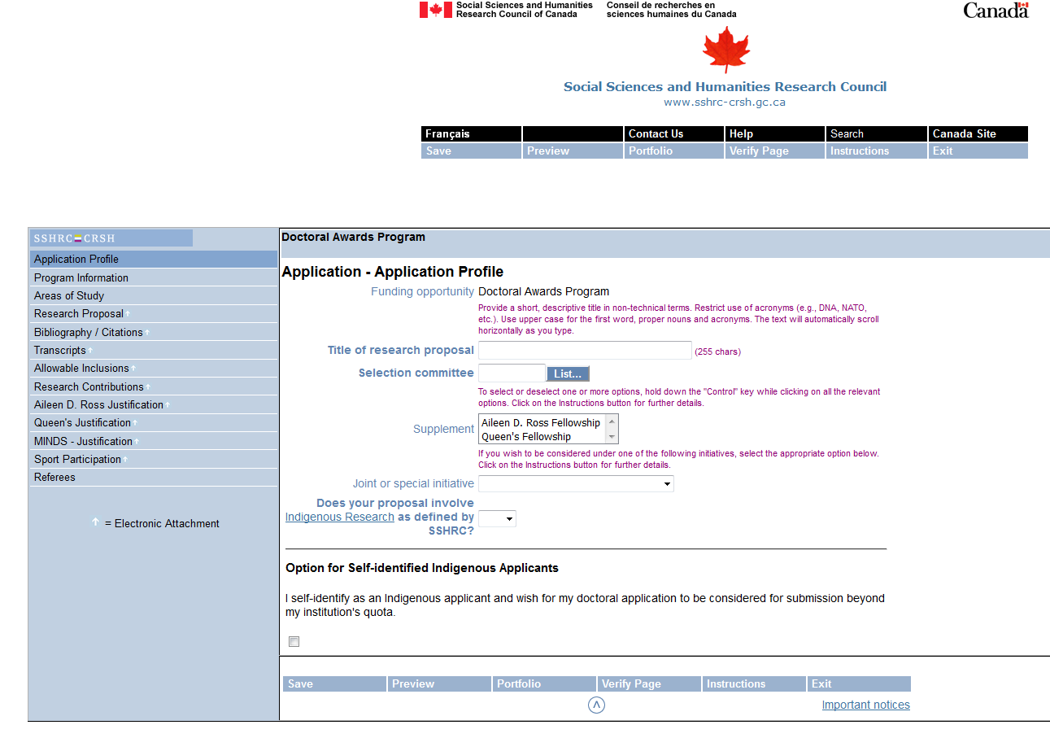
Edit application form
Notes:
This is what the application itself will look like. Like in the CV section, the list of components are on the left. The Save, Portfolio, verify page and instructions are listed across the top menu.

Slide 41
Application profile: indigenous applicants
Applicants who are Indigenous [First Nations (North American Indian - Status and Non-Status), Métis, or Inuit] are encouraged to self-identify their status on their SSHRC Doctoral application form as universities are permitted to recommend to the national competition self-identified Indigenous applicants above the institution’s application quota.
In order to be considered for this, Indigenous applicants are asked to select the “Option for Self-Identified Indigenous Applicants” in the “Application Profile” section of the online application form. Once completed, this information will only be visible to university administrators. Self-identification data are not seen or used by SSHRC’s selection committee members or by the applicant’s references.
Notes:
We’d like to draw your attention to the Option for Self-Identified Indigenous applicants as I noted in an earlier slide. This is where you would select this option.

Slide 42
INDIGENOUS APPLICANTS
Indigenous applicants are encouraged to complete the allowable inclusion section to explain any special circumstances that may have delayed their academic career (e.g., cultural or community responsibilities, and/or challenging socio-economic contexts). This information should be taken into account by selection committee members.
Applicants may identify a proposed program of study as Indigenous research, such that SSHRC’s Guidelines for the Merit Review of Indigenous Research will apply.
INDIGENOUS research

Slide 43
Application profile: selection committee
Notes:
In order to choose a selection committee, you would select the 'list' button to open up the full list of options.

Slide 44
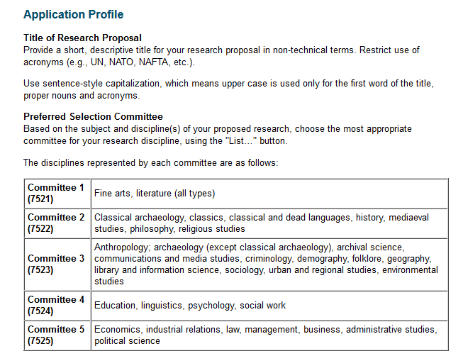
Application profile: Selection committee
Notes:
And these are the 5 committee options you can choose from - note in the instructions above the list, under Preferred Selection Committee, it reads: ​Applicants select the one that is closest to their research area. So if you don't see your exact research area listed, please select what you think would be the closest one. Be reminded that committees are mostly multi-disciplinary so the member reading your application might not be in your area of expertise. Be sure to keep that in mind when writing your research proposal.

Slide 45
Supplements & Joint or special initiatives
Notes:
Supplements are additional awards available to SSHRC applicants but each supplement funds different areas of research. You will need to refer to the SSHRC website to see if your research falls under any of the Supplement or Joint/Special Initiative areas and apply for those. And, please do follow the instructions on how to apply for those to be considered for extra funding.

Slide 46
Supplements
Aileen D. Ross Fellowship
A $10,000 supplement is awarded yearly to a SSHRC doctoral award recipient conducting poverty-related research in sociology.
Queen’s Fellowship
A $10,000 supplement is awarded yearly to a SSHRC doctoral award recipient entering a Canadian Studies program at a Canadian postsecondary institution. At the time of application, SSHRC considers eligible candidates who are either registered in the first year of a Canadian Studies program, or who intend to enroll in such a program.

Slide 47
Special initiatives
Department of National Defence MINDS Scholarships Initiative
SSHRC and the Department of National Defence (DND) partner to offer doctoral awards to individuals conducting social sciences and humanities research in areas related to the Mobilizing Insights in Defence and Security (MINDS) Policy Challenges and/or Canada’s defence policy, Strong, Secure, Engaged. The MINDS Initiative Doctoral Awards are valued at $35,000 per year and are tenable for up to 36 months. Learn more about the MINDS Scholarship Initiative.
Sport Participation Research Initiative
SSHRC partners with Canadian Heritage through the Sport Participation Research Initiative to provide $10,000 doctoral award supplements. http://www.sshrc-crsh.gc.ca/funding-financement/programs-programmes/sport_can-eng.aspx

Slide 48
Special initiatives
Initiative for Digital Citizen Research
Through the Initiative for Digital Citizen Research, Canadian Heritage and SSHRC partner to offer doctoral award supplements, valued at $10,000, to individuals who are conducting research related to online disinformation as well as their impact in the Canadian context. Comparative approaches to these themes that are inclusive of, but extend beyond, the Canadian context are also eligible for supplementary funding.
https://www.canada.ca/en/canadian-heritage/services/online-disinformation/joint-initiative-digital-citizen-research/insight-grants.html

Slide 49
Supplements Justification & Joint or special initiatives
maximum one page per supplement/initiative
Applicants who indicate their interest in these supplements/initiatives must provide a maximum one-page justification, per supplement/initiative, indicating how their program of study responds to the objectives.
Justification pages for supplements and joint initiatives will not be visible in the university’s version (PDF) of the application.

Slide 50
Program information
Choose “a)” if currently registered at the University of Toronto in a degree program or will be registered for the Fall 2023 session
Choose “b)” if not currently registered and will not be registered for Fall 2023 session in a degree program but were registered at any other time during the calendar year of 2023 (January 1-December 31)
If an applicant choses “c)” or “d)” the application will be submitted directly to SSHRC; we will not be able to see this application at all
Notes:
The next section after the application profile, is program information.
This is something we want to draw your attention to as the program information you select will determine where your application is submitted. I mentioned that you can apply through an institution or directly through SSHRC so it’s important to choose carefully. If the application is submitted incorrectly to SSHRC, it would be deemed ineligible as it’s too late to enter the university competition by the time SSHRC verifies your registration with SGS. If you are unsure about what to select, please feel free to clarify with me. My contact information is included in the last slide of today's presentation.

Slide 51
Organization at time of application
All different types of institutes and units are included in the “Department/Division” list, be sure to choose the correct name of your graduate unit (department) so your application can be identifiable for your department
Notes:
We request a list of applications from SSHRC each year to help graduate units identify your application. Be sure to follow your graduate unit’s submission instructions as they likely require you to email them separately confirmation that you submitted the application on the system.

Slide 52
Program information: registration status
Expected start date: If you are currently holding an award that ends August 31, 2024, choose a September 2024 start date.
Number of months of doctoral studies: Should always be denominations of 4; e.g., if started in September and remained full-time without leaves, should be either 4, 16, 28, and 40. If haven’t started doctoral studies yet, enter 0.
Notes:
START WITH SUPPORT REQUESTED: As you see, you have to select an expected start date of the award. You can change your start date if awarded but if you know, for example, you have a major award ending in August, choose Sept. Or your graduate unit may also require all major awards to start in Sept ...above
In the section below that, you have to enter the number of months of doctoral studies ...above
If you’re unclear on how to complete this section and would like some assistance on calculating your months of study, please contact me and provide me with your student number if applicable and I'll be able to help you.

Slide 53
Research proposal
Maximum 2 pages
Must be a PDF ATTACHMENT
REQUIRED ELEMENTS TO BE INCLUDED if not currently enrolled in a doctoral degree program:
clearly state your current level of study;
give the title and a brief description of your master's thesis or research project, if applicable;
identify the degree program that you will pursue, including any relevant courses, and provide an explanation for your choice; and,
provide an outline of your doctoral thesis or research project, including the research question(s), context, objectives, methodology and significance and expected contribution to the advancement of knowledge, and your special interests in the proposed area of research.

Slide 54
Research proposal continued
REQUIRED ELEMENTS TO BE INCLUDED if you are currently enrolled in a doctoral degree program:
clearly state your current level of graduate study;
indicate at what stage you are in your thesis/research project;
provide the name of your supervisor of doctoral studies, if known;
provide an outline of your thesis or research project, including, for example, the research question(s), context, objectives, methodology and significance and expected contribution to the advancement of knowledge; and
describe what you hope to accomplish during the award tenure and what will remain to be done before you obtain your degree.

Slide 55
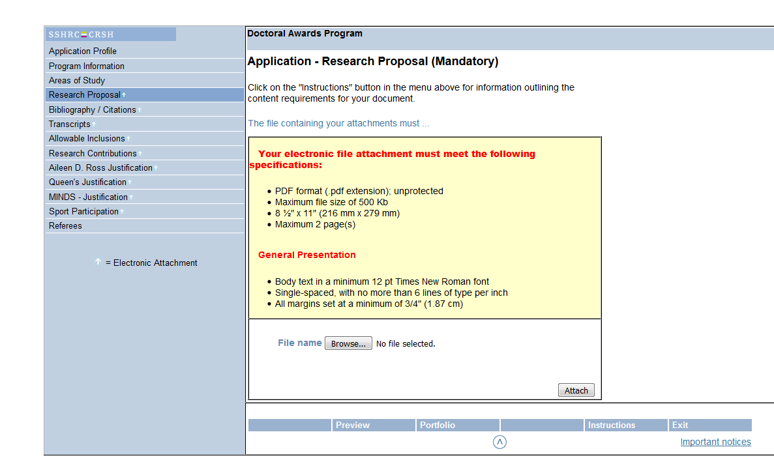
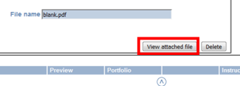
Research proposal
Notes:
On the system, you can ...click on …
And please note that there are specifications for the electronic file that must be met. When you're ready to upload, select 'browse', choose your file, and 'attach'. Once the file is attached, you will have the option to 'view the attached file.

Slide 56
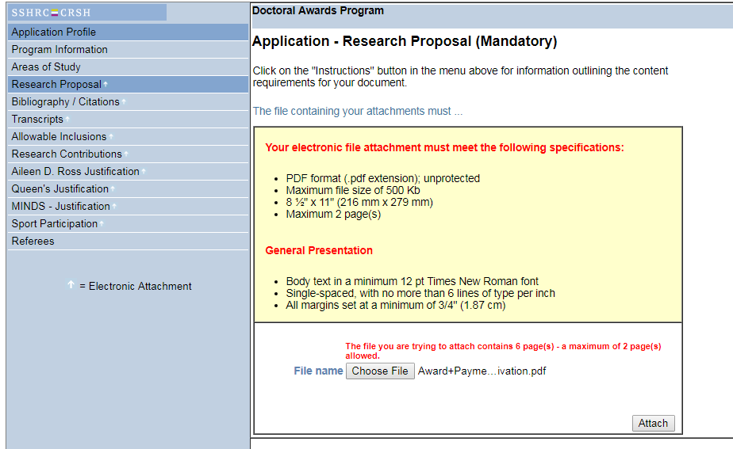
Research proposal
Notes:
If there are any issues with the file, you will receive an error message that one or more of the specifications wasn't met. Once everything has been rectified and you upload the file and there are no other issues, you move on to the next section.

Slide 57
Bibliography & citations
Maximum 5 pages
a bibliography for your proposed research (do not upload publications or include endnotes); and
bibliographic details for all citations included in your research proposal (ensure that these are clear and complete to allow reviewers to locate the sources easily). Only use the space that you need, i.e., don’t try to fill up all 5 pages.

Slide 58
Common mistakes
Lack of focus or coherence
Repetitiveness
Failure to cite important work in the area
Failure to cite recent relevant work
Citing too many irrelevant articles
Relying too much on secondary sources (lack of understanding)
Too much detail on minor issues; too little detail on major issues
Research contributions not properly highlighted
Impact / importance of research not explained
Notes:
So, please do pay careful attention to these common mistakes as you write your research proposal

Slide 59
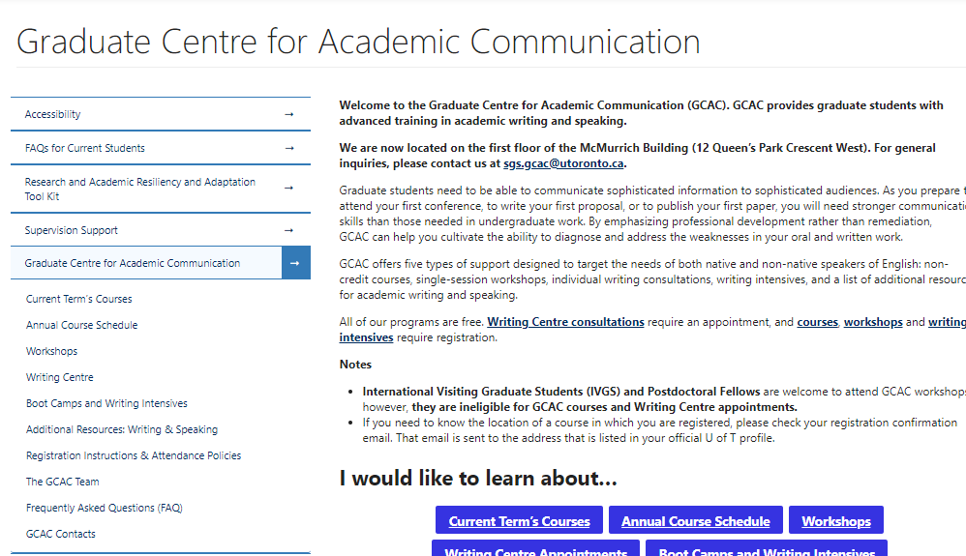
Graduate centre for academic communication
GCAC offers bootcamp/intensive courses and workshops for proposal writing. They also offer one-on-one appointments to help review proposals
https://www.sgs.utoronto.ca/resources-supports/gcac/
Notes:
Please check their website for any upcoming sessions.

Slide 60
Diversity in research
The Diversity Considerations in Research Design module supports SSHRC's commitment to promoting the integration of equity, diversity and inclusion - (EDI) related considerations in research design and practices, as outlined in the Tri-Agency Statement on Equity, Diversity and Inclusion, and the Tri-Agency Equity, Diversity and Inclusion Action Plan.
All SSHRC doctoral award applicants must complete this module.
This part of your application will not be subject to merit review and will not be shared with committee members.
Whether an applicant selects “Yes” or “No” to whether or not diversity considerations apply to their proposed research design, they must provide a maximum 1,700 character explanation.

Slide 61
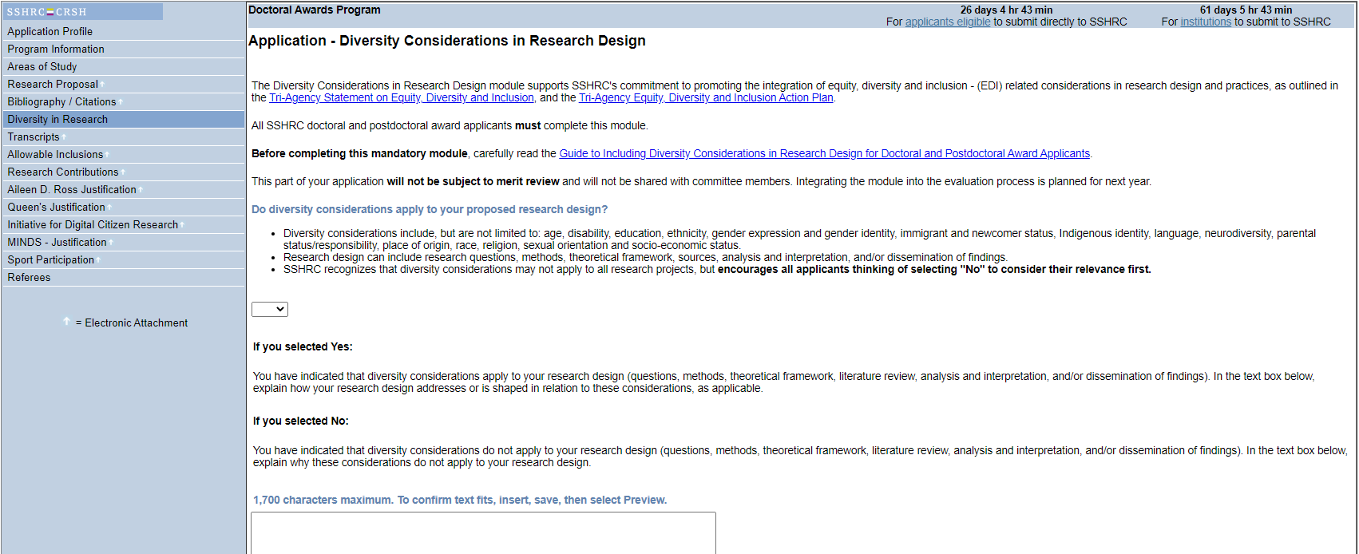
Notes:
And here is what the page looks like...

Slide 62
transcripts
Students must upload their own up-to-date undergraduate and graduate transcripts as ONE PDF file.
If student is already registered in program of study at the time of application, must submit a transcript for this program, regardless of the number of months completed, to demonstrate registration in the program, e.g., Fall 2023, even if there are no grades.
Note: SSHRC will not reject unofficial transcripts. However, applicants should note that submission of an application will continue to serve as a formal attestation that they provided true, complete, accurate information in the application and its related documents.
The Tri-Agency may contact administrative staff at applicants’ institutions or applicants directly in order to verify that the contents of the submitted transcripts are true, complete and accurate.
SGS recommends students to submit official transcripts whenever possible as reviewers will find them easier to read and authenticity will not be questioned.
Official e-transcripts are acceptable but should be “printed to PDF” before uploading or combining with other transcripts to remove encryption (e.g., using web browser, Adobe Acrobat Reader, or freely available PDF software).

Slide 63
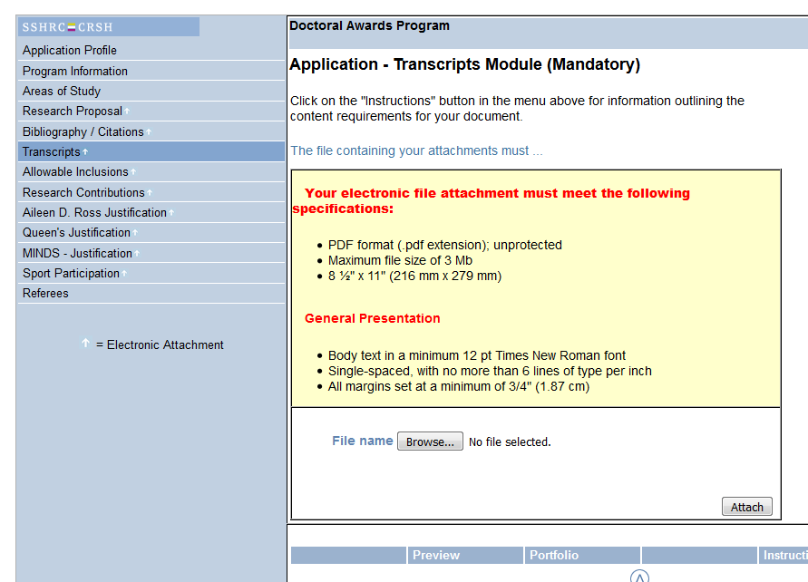
transcripts
Notes:
This is what that transcript page looks like in the application. And again, there are specifications for the file so please pay careful attention to those. You will then attach the file and if there are any issues with the file you’ve uploaded, you’ll be notified. Then, just adjust accordingly until the uploaded file no longer has any issues. You should still view the transcript after it’s been uploaded, to make sure it opens correctly on the system and that it’s legible.

Slide 64
Allowable inclusions
Maximum 1 page (only if applicable)
If applicable, attach a PDF document.
Describe any special circumstances that have had an effect on performance or productivity.
SSHRC asks its selection committees to consider special circumstances that could have affected applicants’ research, professional career, record of academic or research achievement, or completion of degrees. Relevant circumstances could include administrative responsibilities, maternity/parental leave, child-rearing, illness, disability, cultural or community responsibilities, socio-economic context, health-related family responsibilities, trauma and loss, or the COVID-19 pandemic.
Indigenous applicants are encouraged to fill out this section to describe special circumstances that may have had an impact on their academic or career paths.
If the current or previous thesis supervisor is unable to provide a Letter of Appraisal, applicants may use this section to provide an explanation. It would be considered normal to not have a new supervisor be a referee, or for students just starting their program to not have a supervisor yet, but applicants can still explain here to minimize any doubts for the reviewers.
All information provided to SSHRC is subject to the Privacy Act. Applicants are reminded that the information included in the “Allowable inclusions” section of their application will be shared with selection committee members for consideration as part of their application. SSHRC merit reviewers cannot share this information outside of the merit review process, which is subject to the Tri-Agency Conflict of Interest and Confidentiality Policy. For more information, see the principles for SSHRC merit review.

Slide 65
Research Contributions, Relevant Experience and Activities
Maximum 2 pages for both sections combined
Follow the detailed instructions: https://www.sshrc-crsh.gc.ca/funding-financement/instructions/doctoral/doctoral-eng.aspx#contributions
Given the page limits, be selective and summarize information where appropriate.
Part I – Research Contributions
Provide details (in point form), as per SSHRC instructions, on the contributions you list.
Part II – Applicant’s Statement
Describe (in narrative form) your relevant research experience, training, professional, academic and extracurricular activities. Use two headings: Relevant experience and Relevant activities.

Slide 66
Referees – letters of appraisal
It is the applicant’s responsibility to ensure that all required application components have been submitted (including all attachments and letters). The system does not allow submission of incomplete applications.
Contact referees early to inquire about a possible POSITIVE & enthusiastic reference.
Pick the referees (preferably academic) who will provide the best reference to you.
Notify your referees in advance that they will be receiving an invitation by email with the subject line “Invitation to provide a letter of appraisal—Invitation à fournir une lettre d’appréciation.”
Make sure to give your referees enough time to complete and submit their support letter in advance of your graduate unit deadline date.
Referees can see your in-progress application on the system

Slide 67
Implicit or Unconscious Biases
The Tri-Agency expects reviewers to consistently guard against the possibility of unconscious bias influencing the decision-making process, whether these biases are based on schools of thought, the perceived value of fundamental versus applied research, areas of research or research approaches (including emerging ones), size or reputation of an institution, age, gender, and/or other personal factors associated with the applicant. To assist committee members in recognizing potential bias, all SGS members are asked to complete the Unconscious Bias in Peer Review online learning module. Members are also encouraged to complete one of the Sex and Gender training modules produced by CIHR.
Encourage your supervisor and referees to also complete the Unconscious Bias in Peer Review online learning module so that they can be aware and minimize unconscious bias when writing letters of appraisals, e.g., using different types of adjectives to describe male vs female applicants, such as outstanding male but hard-working female.

Slide 68
Referees – letters of appraisal
Letters must be very strong and enthusiastic as they are a major component of the application.
There is a maximum of 2500 characters for the letters (approx. half a page)
In addition to assessing your research ability/potential and the relevance of your experience and achievements obtained within and beyond academia, referees should demonstrate how your attributes and qualifications surpass selection criteria and why you are worthy of receiving the award
Feel free to remind them of your contributions and information you would like to have in the letter (screenshot available in this presentation);
Follow-up prior to the deadline (note you must have both references completed before you can submit your application); and
Remember to give them a big thank you.

Slide 69
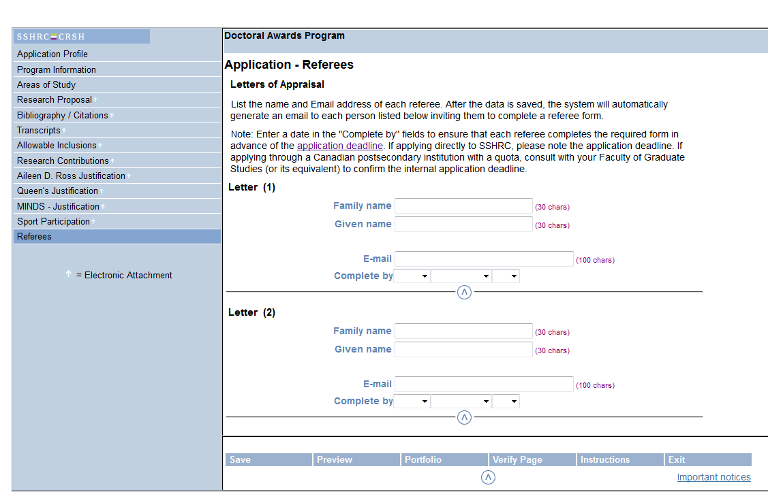
Referees – letters of appraisal
Notes:
Note that you enter a “complete by” date for the referee (to be part of the invitation email), but the link will still be available after this date. Pick a date well before your graduate unit deadline date.

Slide 70
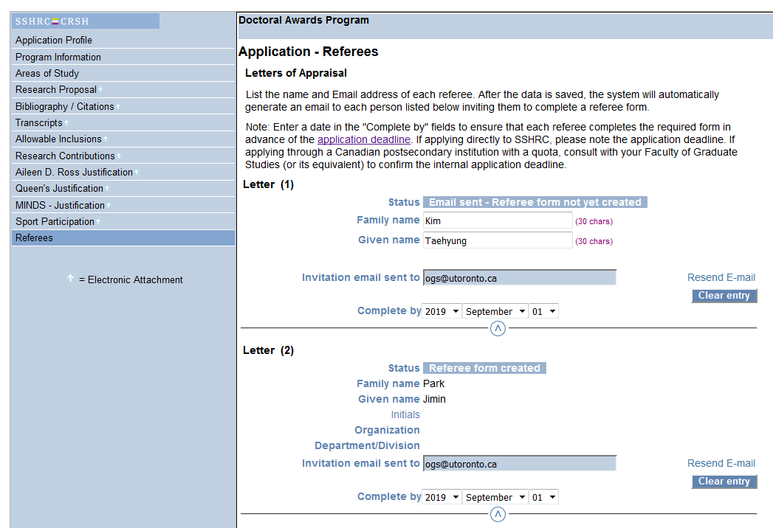
referees
You can track the status of the “Letters of Appraisal” on the system

Slide 71
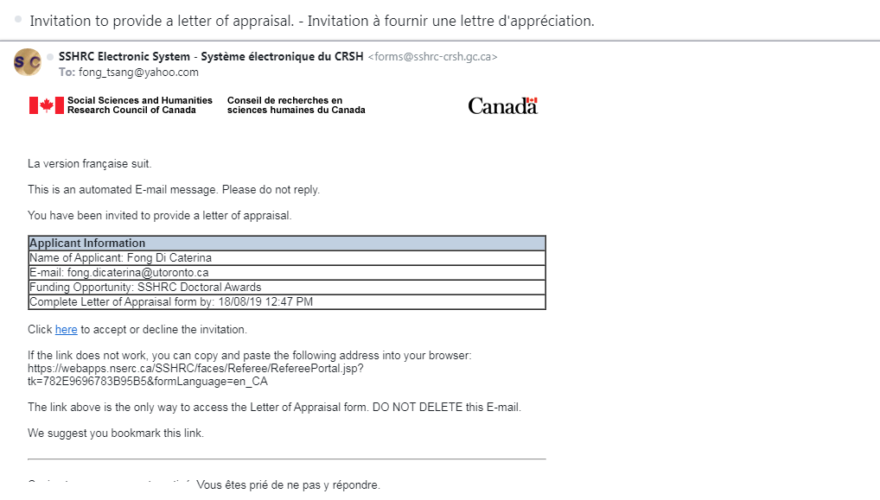
Referee request email
From: SSHRC Electronic System - Système électronique du CRSH forms@sshrc-crsh.gc.ca
Subject: Invitation to provide a letter of appraisal.

Slide 72
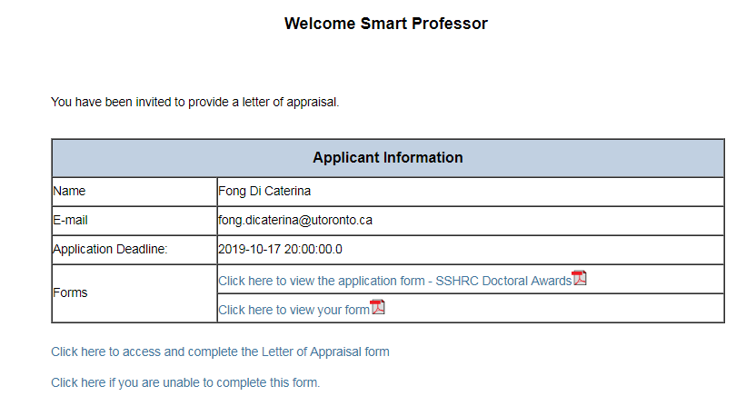
Referee initiation page

Slide 73
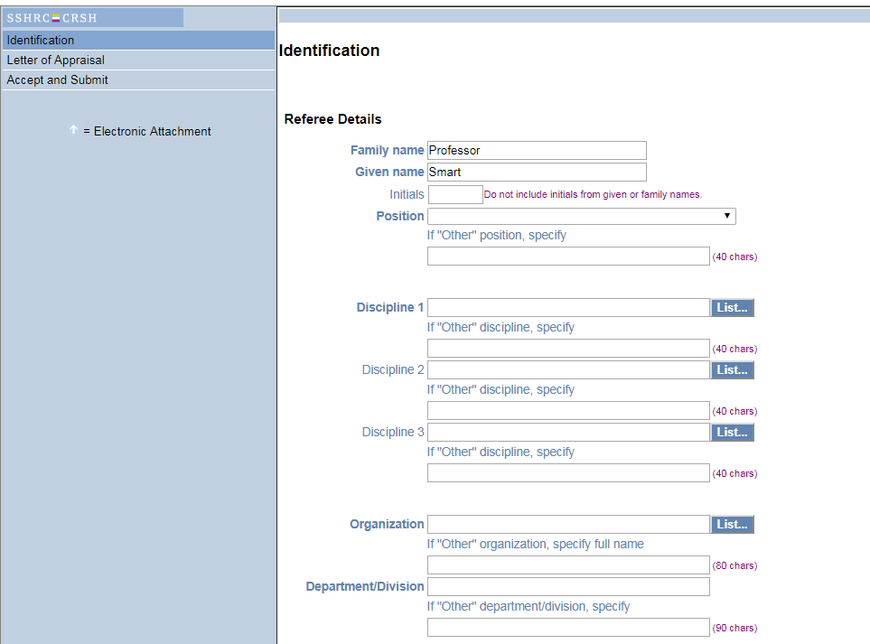
Referee form: identification
Notes:
Here is where the referee provides their biographical information, full name, position, and their disciplines. They also provide information on the organization they’re with, as well as which department they’re in. Once they’ve saved this page, they move on to the next section, which is…

Slide 74
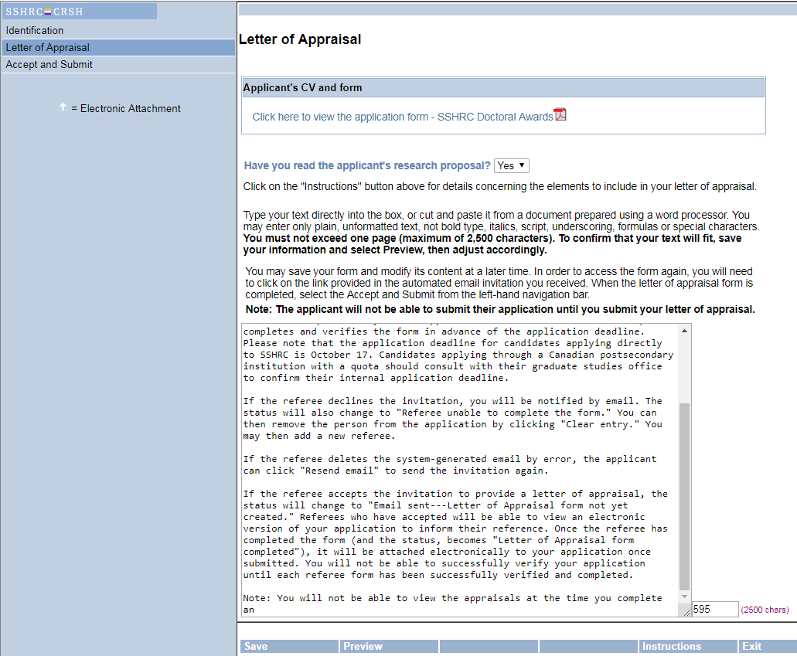
Referee form: letter of appraisal
Notes:
The letter of appraisal itself. The character count is provided for referees at the bottom right and the save button is on the bottom left of the page. Referees need to make sure their text fits. If they simply copy and paste, and their letter is too long, the system will simply cut off their letter at the character limit.

Slide 75
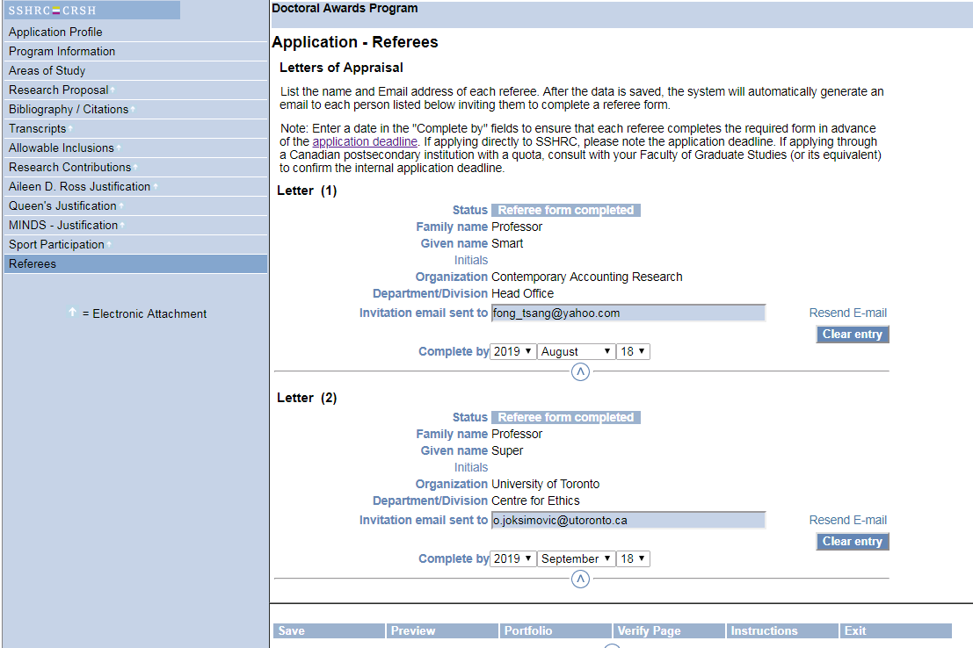
referees
Notes:
Once the letter of appraisal is submitted, you will see an update in the referee section of your application form. The status will change to ‘referee form completed’.

Slide 76
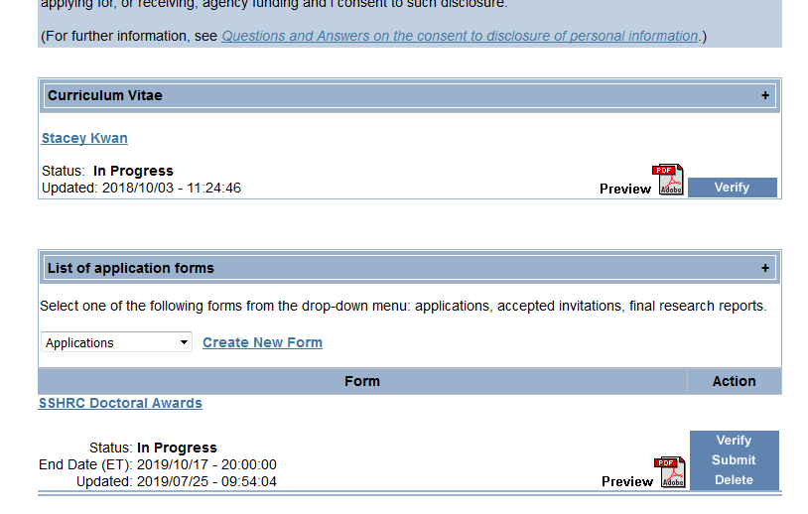
Verifying & submitting
Notes:
Once you have the letters of appraisal and everything else has been completed, you move on to the step of verifying and submitting your application.
You can see that on the right-hand side under the list of application forms, you have the option to ‘verify’, ‘submit’ or ‘delete’. You also have the ‘preview’ button, which we strongly recommend you exercise by clicking the “Preview PDF” option to ensure that the application form is accurate and complete before submitting.

Slide 77
Verifying & submitting
Notes:
So for both the CV section and the Application Form section, please preview the PDF. Once you’ve previewed both and are 100% sure you are ready to submit, verify everything and then submit your application.

Slide 78
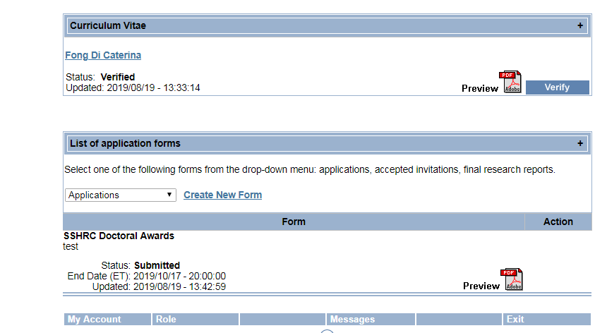
Confirmation of submission
Graduate units may ask students to submit a screenshot of their application page (sample below) to demonstrate that they submitted their application by the graduate unit deadline. Please be sure to check with your graduate unit to verify if you are required to notify the grad unit that you have submitted an application

Slide 79
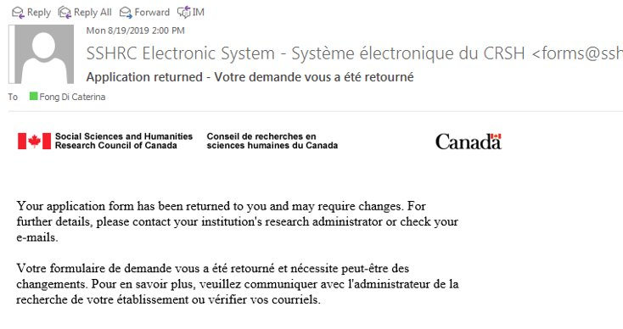
Returned application
Applicants may have their application returned to them if a change is required by the graduate unit. If this happens you will receive an email from the application system. Your grad unit should email you first to inform you why your application is being returned, however if they have not, please check the “messages section” of your application or contact the grad admin at your unit directly to find out why your application has been returned

Slide 80
Adjudication process
Three tier adjudication process
Graduate unit review - graduate unit reviews all applications submitted to the unit and nominates a quota number of applications to SGS for review
SGS review – SGS reviews all applications received from units for the university-wide competition. At SGS there are two SSHRC sub-committees, a Social Sciences committee and a Humanities committee,​ which select the top applicants to forward to SSHRC for the national competition. Each file is read by three committee members who are outside of the applicant’s department.
SSHRC review – SSHRC reviews all applications received for the national competition and selects the recipients of the SSHRC CGS D and SSHRC Doctoral Fellowships
You should receive an email from your department letting you know if your application was forwarded to SGS. If forwarded to SGS, we will also let you know whether your application is being forwarded to SSHRC.​ If forwarded to SSHRC, SSHRC will inform applicants of their results at the end of April 2024 using an "extranet" system for students. Applicants are notified how to access the system via email.

Slide 81
APPLICATION WEIGHTING
Full selection procedures can be found on the SSHRC website:
http://www.sshrc-crsh.gc.ca/funding-financement/programs-programmes/fellowships/doctoral-doctorat-eng.aspx#6
Criteria | Weighting
Research Ability and Potential | 50 %
Relevant experience and achievements obtained within and beyond academia | 50 %

Slide 82
Sshrc results
University of Toronto statistics
Competition Year | Applications Received at SGS | Quota Forwarded to SSHRC | Awards Received | Success Rate of Apps forwarded
2017-2018 | 311 | 238 | 117 | 49.1%
2018-2019 | 312 | 243 | 110 | 45.2%
2019-2020 | 301 | 246 | 101 | 41.1%
2020-2021 | 342 | 276+7 | 128 | 45.23%
2021-2022 | 322 | 246+8 | 134 | 53.17%
2022-2023 | 328 | 250+9 | 125 | 48.26%
2023-2024 | 327 | 250+9 | 127 | 49.03%
Notes:
Before we get into the actual application itself, here are some recent statistics for U of T. Read last year’s details…

Slide 83
Sshrc results
National statistics
Competition Year | Applications Received at SSHRC | Total Awarded | Success Rate
2016-2017 | 1982 | 905 | 45.7%
2017-2018 | 2043 | 860 | 42.1%
2018-2019 | 2047 | 860 | 42.0%
2019-2020 | 2205 | 938 | 42.5%
2020-2021 | 2584 | 1058 | 40.9%
2021-2022 | 2390 | 1028 | 43.0%
2022-2023 | 2294 | 1077 | 46.9%
Notes:
Some national statistics now. You can see what the success rate is for all applicants forwarded to SSHRC across Canada. The success rate hovers around early to mid-40%.

Slide 84
Michael smith foreign study supplement (MSFSS)
To support high-calibre graduate students in building global linkages and international networks through the pursuit of exceptional research experiences at research institutions outside of Canada.
Available to active CGS Master’s, CGS Doctoral or eligible Vanier CGS holders
Up to $6,000 to fund 2 to 6 months of travel
Eligibility to hold an MSFSS
hold an active CGS at the time your study period abroad starts;
be registered full time in a graduate research studies program at a Canadian institution for the duration of the time abroad;
take up the award within one year of receiving the notice of award for the CGS Michael Smith Foreign Study Supplement; and,
return to complete your degree in Canada.

Slide 85
Michael smith foreign study supplement
Deadline for universities to submit applications to the granting agencies: June 10th and October 10th
Students submit application and all required documents to the School of Graduate Studies for consideration

Slide 86
Parental Leave Funding
Federal agency (CIHR/NSERC/SSHRC/Vanier) scholarship parental leave supplements:
Up to 12 months of paid parental leave equal to award amount.
Amount dependent on # of sessions of leave.
Submit Request for Deferment of Start Date or Interruption of Award.
Must be active award holders to "interrupt" the award.
Parental leave supplements through supervisor’s Tri-agency grant:
Apply through supervisor and Research Services Office
Notes:
(Please also let me know if you’re submitting LOA paperwork for a CIHR CGS D recipient, as I will need that notice in order to ensure that parental leave supplements are set up on ROSI.)

Slide 87
What Makes a Great Merit-Based Application?
Advice from Graduate Awards Office & Prof. Malcolm Campbell - Former Vice-Principal Research, UTSC
Reviewers can spend as little as 6-8 minutes on each application, you have a short period of time to promote yourself on paper.
Selection/Evaluation Criteria – make sure you “hit” them all

Slide 88
Academic achievements
Reviewers look heavily at PROGRESS; ongoing awards, publications, historical grade trends, and PRODUCTIVITY
Your contributions/role in a project, impact of the work, awards, presentations, research background, communication achievements, leadership roles (volunteer, elected positions, clubs, sports, etc.)
Limit to university level achievements
Notes:
Read first 2,
You want to limit your academic achievements to university-level achievements

Slide 89
Writing style/formatting
Make it easy for the reviewer to find key information
Use headings
Apply boldface or underlined text strategically
Be clear, succinct, scholarly but understandable
Be straight forward, emphasize strengths, not a time to be shy
Follow formatting standards

Slide 90
Research Proposal/Plan of Study
Write a clear and concise research proposal that an educated non-expert could understand
Give your proposal to as many people as possible to review – ideally a professor/ senior graduate student who can critique it
Read the proposal out loud to yourself and others. If it doesn’t sound natural, then it needs more work
Engage the reviewer
Importance/Significance – you want your reviewer to advocate for your application
Notes:
FINAL POINT, ‘and you really want to emphasize and highlight the important and significance of your work…

Slide 91
Questions?
Competition (application/submission) questions can be directed to:
Graduate Awards Office
graduate.awards@utoronto.ca ​
Technical difficulties with the application system can be directed to SSHRC’s help desk:
webgrant@sshrc-crsh.gc.ca
Notes:
Thank you all for attending! We will now move onto the Q&A portion of today’s session. So, if you have any questions, please feel free to enter them into the chat and we will address them in the order they come in. Fong, are there are any questions already in the chat that we should go back to?

